Slide 1
Use Case 1 and Use Case 5 Simulation Results

Slide 2
Use Case 1
Peak load management
double-auction market (mode: NONE)
controllers(bidders)(bid_mode: ON)
Model: model_test_market_attack.glm

Slide 3
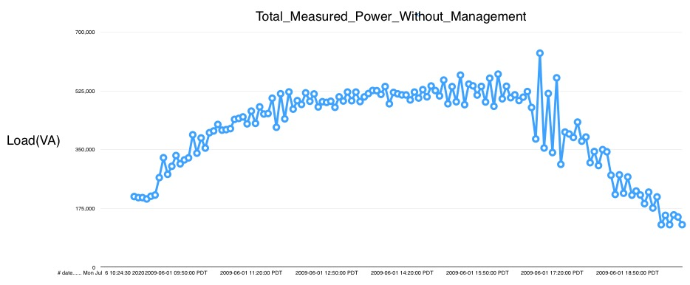

Slide 4
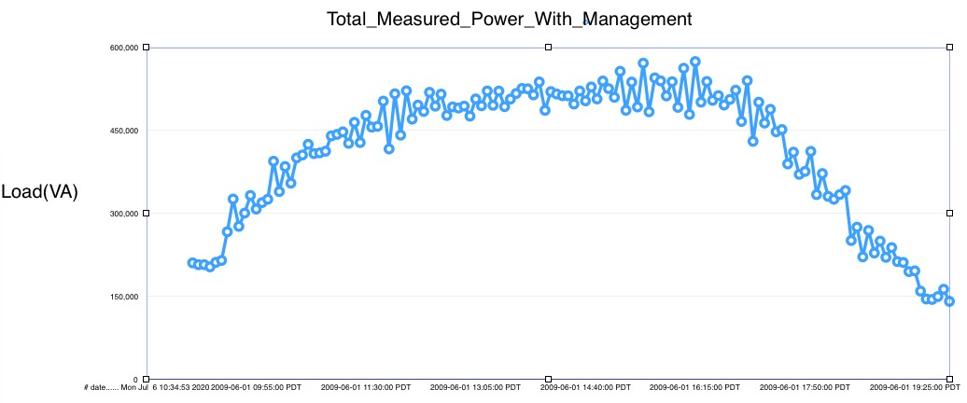

Slide 5
Use Case 5
Simulate an island mode microgrid when disruptive event happens in the main grid
Recloser object (same function as switch, but can auto-detect the fault condition in main grid)
Model: new_microgrid.glm

Slide 6
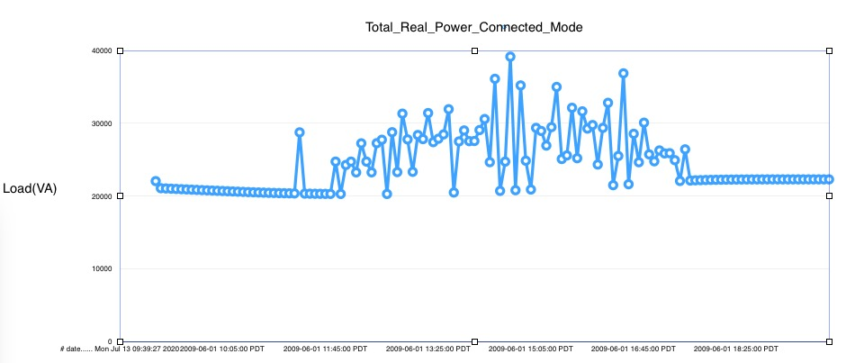

Slide 7
